Slide 1
Artificial Intelligence and Machine Learning Project
Team Details:
Manan Magu (2210990552)
Namit Gulati (2210990595)
Manya Jain (2210990563)
Lovisha Bansal (2210990546)
Faculty Coordinator: Mr.Shubham Singhal
:
Chitkara University Institute of Engineering and Technology,
Chitkara University, Punjab

Slide 2
Table of Contents
Abstract
Introduction
Problem Statement
Face recognition
Objectives
Methodology
Tools and technologies
Testing / Experimentation
Applications
Result
Future scope

Slide 3
Abstract
■ Security has become a major issue globally and in order to manage the security challenges and reduce the security risks in the world, biometric systems such as face detection and recognition systems have been built.
■ These systems are capable of providing biometric security, crime prevention and video surveillance services because of their inbuilt verification and identification capabilities . This has become possible due to technological advancement in the fields of automated face analysis, machine learning and pattern recognition. biometric and facial recognition techniques.
■ For this, Viola-Jones Algorithm, Local Binary Pattern Histogram Algorithm and Neural Network Plays a major role. There are lot of machine learning and image processing library.
■ This project is mainly based on OpenCV and NumPy i.e., a model is created using these libraries. To create model, dataset (labelled data) is required which is generated using OpenCV and for visualization of output, another dataset (without labelling) is generated and this time, a model predicted the label (i.e., name) of that image.

Slide 4
Introduction
Face recognition has gained tremendous attention over the last three decades since it is considered a simplified image analysis and pattern recognition application.
There are at least two reasons for understanding this trend: (1) the large variety of commercial and legal requests, besides (2) the availability of the relevant technologies (e.g., smartphones, digital cameras, GPU, ...).
Although the existing machine learning/recognition systems have achieved some degree of maturity, their performance is limited to the conditions imposed in real-world applications.
Today facial recognition, associated with artificial intelligence techniques, enables a person to be identified from his face or verified as what he claims to be. Facial recognition can analyze facial features and other biometric details, such as the eyes, and compare them with photographs or videos.

Slide 5
Problem Statement
■ The Problem statement of Face Recognition for Real-Time Applications are given below:-
To do face detection and recognition in real time.
Enhance the Speed i.e., frames/sec.
Do recognition on high Camera resolution.
There might have been number of situation where it is necessary to recognize face or simply detect face. The traditional methods of lock/unlock are very inefficient. There may be possible of losing keys or breaching of codes/passwords.
So, we propose a face recognition system which can be able to recognize face with maximum accuracy as possible.

Slide 6
Face Recognition
Face recognition has progressed from rudimentary computer vision techniques to advances in machine learning to increasingly sophisticated neural networks and related technologies;
In engineering, the issue of automated face recognition includes three key steps: (1) approximate face detection and normalization, (2) extraction of features and accurate face normalization, and (3) classification (verification or identification).
Face detection is the first step in the automated face recognition system. It usually determines whether or not an image includes a face(s). If it does, its function is to trace one or several face locations in the picture.
Feature extraction step consists of extracting from the detected face a feature vector named the signature, which must be enough to represent a face. The individuality of the face and the property of distinguishing between two separate persons must be checked. It should be noted that the face detection stage can accomplish this process.
Classification involves verification and identification. Verification requires matching one face to another to authorize access to a requested identity. However, identification compares a face to several other faces that are given with several possibilities to find the face's identity.

Slide 7
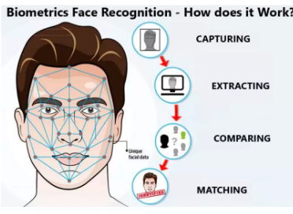
Face Recognition

Slide 8
Objectives
The objectives of this system are as follows:
Detect faces.
Match detected faces to the images previously captured and recognize them.
Provides accurate information about them (e.g., their names).
To enhance the Frame/sec for Face Recognition System, such that Recognition is done in Real Time.
Presently, work on 15 frames/sec Our motto is to achieve higher frames/sec or high-Resolution frames/sec.
We want increase accuracy of face detection and recognition

Slide 9
Methodology
■For this project we will be using the Agile Software Development methodology approach in developing the application.Agile methodologies are approaches to product development that are aligned with the values and principles described in the Agile Manifesto for software development.
■Agile methodologies aim to deliver the right product, with incremental and frequent delivery of small chunks of functionality, through small cross-functional self-organizing teams, enabling frequent customer feedback and course correction as needed.
In doing so, Agile aims to right the challenges faced by the traditional "waterfall" approaches of delivering large products in long periods of time, during which customer requirements frequently changed, resulting in the wrong products being delivered.

Slide 10
Tools and technologies
TOOLS AND TECHNOLOGIES
The proposed system majorly focuses on the use of these main technologies. These technologies can be categorized as the following module:
Computer vision
Image processing
Machine learning
Computer Vision
Computer vision is the field of computer science that focuses on replicating parts of the complexity of the human vision system and enabling computers to identify and process objects in images and videos in the same way that humans do. Until recently, computer vision only worked in limited capacity.
Thanks to advances in artificial intelligence and innovations in deep learning and neural networks, the field has been able to take great leaps in recent years and has been able to surpass humans in some tasks related to detecting and labeling obiectsΣ

Slide 11
Testing / Experimentation
■ In our software project we perform functional testing operation, functional testing is a part of manual testing;
Unite Testing
Unit testing is the first level of functional testing in order to test any software. In this, the test engineer will test the module of an application independently or test all the module functionality is called unit testing. The primary objective of executing the unit testing is to confirm the unit components with their performance.
2. Integration Testing
Once we are successfully implementing the unit testing, we will go integration testing. It is the second level of functional testing, where we test the data flow between dependent modules or interface between two features is called integration testing.
3. System testing
Whenever we are done with the unit and integration testing, we can proceed with the system testing. In this type of testing, we will undergo each attribute of the software and test if the end feature works according to the business requirement. And analysis the software product as a complete system.

Slide 12
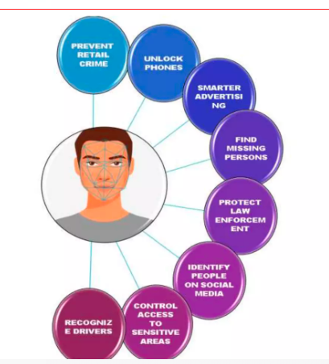
Applications

Slide 13




Results

Slide 14
Future Scope
■ Our current recognition system acquires images from file located Database and from webcam. Scanner support can be implemented for greater flexibility.
■ Currently, our system fails under the vastly varying conditions which we can solve in the future.
What the Future Holds?
The future of facial recognition technology is bright. Forecasters opine that this technology is expected to grow at a formidable rate and will generate huge revenues in the coming years. Security and surveillances are the major segments which will be deeply influenced. Other areas that are now welcoming it with open arms are private industries, public buildings, and schools.
It is estimated that it will also be adopted by retailers and banking systems in coming years to keep fraud in debit/credit card purchases and payment especially the ones that are online . This technology would fill in the loopholes of largely prevalent inadequate password system. In the long run, robots using facial recognition technology may also come to foray. The can be helpful in completing the tasks that are impractical or difficult for human beings to complete.

Slide 15


